Slide 1
UNIVERSITY OF PADOVA ________________________________________________________ MSc in Computational Finance Project: Yield Curve model calibration Ibrahim Uali Riccardo Caruso Enrico Berto Elisa De Colle ________________________________________________________ February 22, 2024

Slide 2
Index
The Nelson-Siegel and Nelson-Siegel-Svensson model
Gradient Descent method
Newton method
BFGS method
LM method

Slide 3
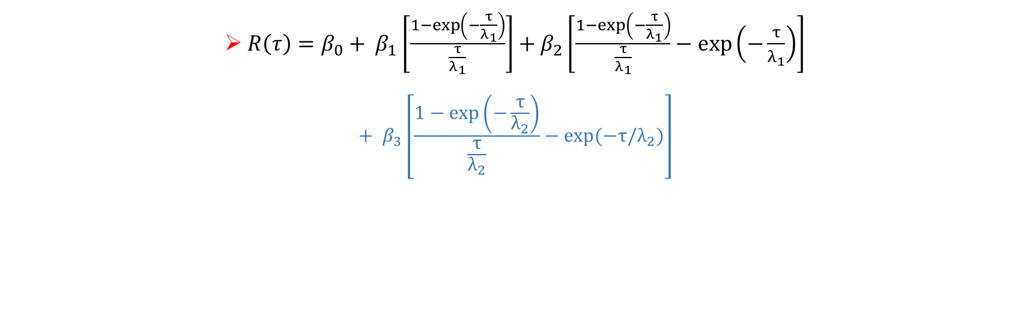
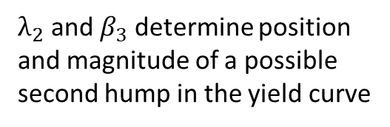
The Nelson-Siegel and Nelson-Siegel-Svensson
Spread
Degree of curvature
(first hump)
Long-term spot rate
${R\left(τ\right)=β}_{0}+ β_{1}\left[\frac{1−\exp\left(−\frac{τ}{λ_{1}}\right)}{\frac{τ}{λ_{1}}}\right]+β_{2}\left[\frac{1−\exp\left(−\frac{τ}{λ_{1}}\right)}{\frac{τ}{λ_{1}}}−\exp\left(−\frac{τ}{λ_{1}}\right)\right]$
$${+ β}_{3}\left[\frac{1−\exp\left(−\frac{τ}{λ_{2}}\right)}{\frac{τ}{λ_{2}}}−exp⁡(−τ/λ_{2})\right]$$
Location of the maximum/minimum of the curvature
$λ_{2}$ and $β_{3}$ determine position and magnitude of a possible second hump in the yield curve

Slide 4
The Project: Data Collection
1 year
2 years
3 years
5 years
10 years
US
Germany
Portugal
South Korea
BONDS
MATURITIES

Slide 5
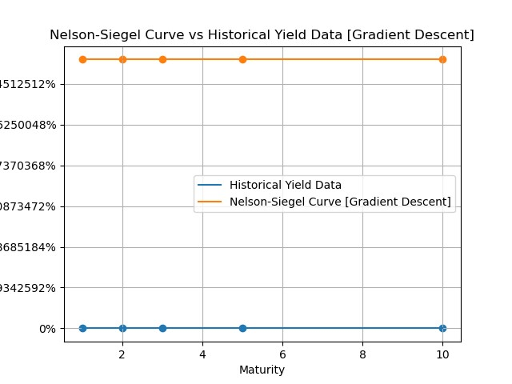
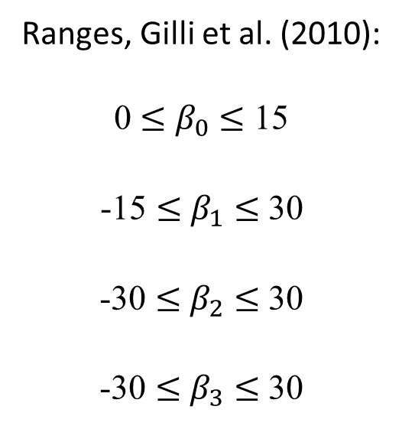
The Gradient Descent method
Initial parameters:
Ranges, Gilli et al. (2010):
0 $≤$ $β_{0}$ $≤$ 15
-15 $≤$ $β_{1}$ $≤$ 30
-30 $≤$ $β_{2}$ $≤$ 30
-30 $≤$ $β_{3}$ $≤$ 30
From these ranges we performed
several iterations in order to find the optimal initial combination. We did it be looking at the plots.
Example with all parameters set to 0.1

Slide 6
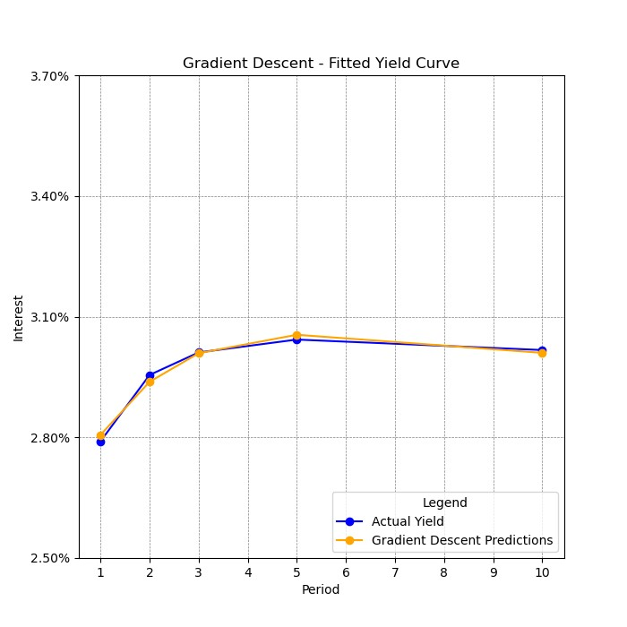
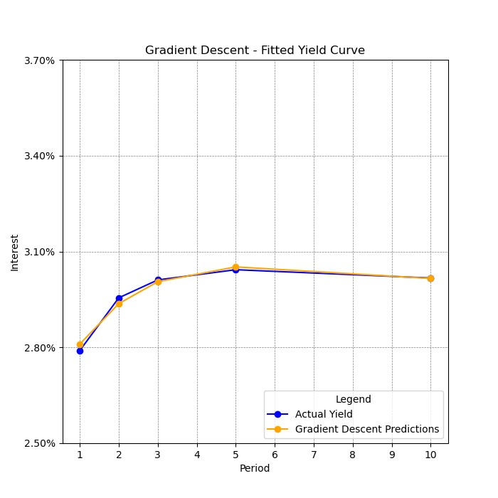
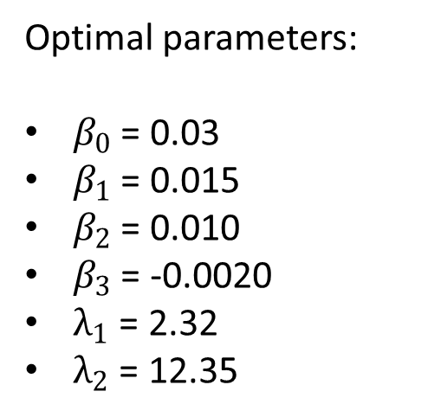
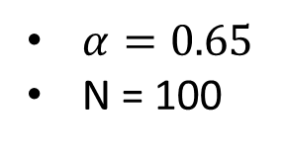
The Gradient Descent method
US:
We present the example of US. The behaviour of the Gradient Descent method is similar for every countries, but parameters and plots are different due to economic conditions.
Optimal parameters:
$β_{0}$ = 0.03
$β_{1}$ = 0.015
$β_{2}$ = 0.010
$β_{3}$ = -0.0020
$λ_{1}$ = 2.32
$λ_{2}$ = 12.35
$α=0.65$
N = 100

Slide 7
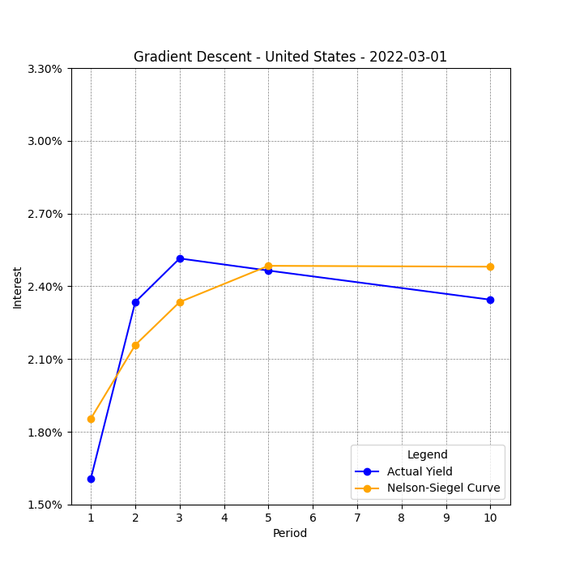
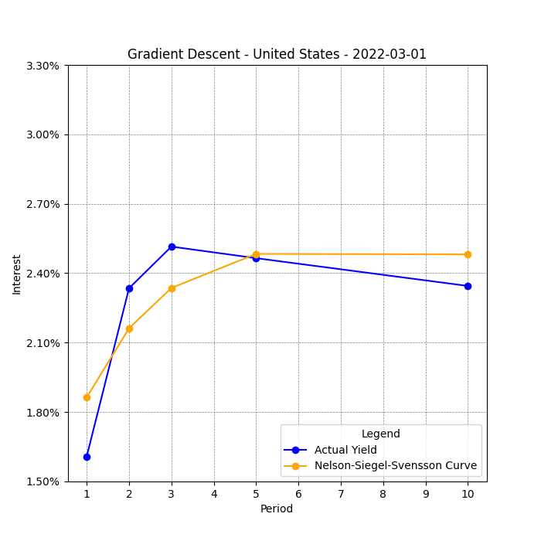
The Gradient Descent method
US:
Bonds with high volatility

Slide 8
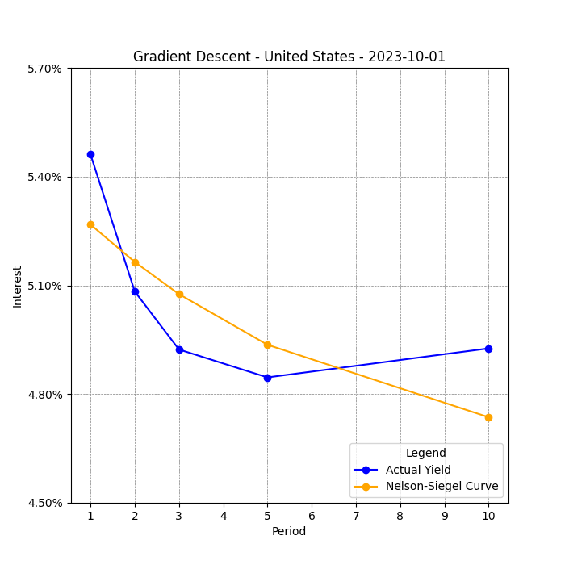
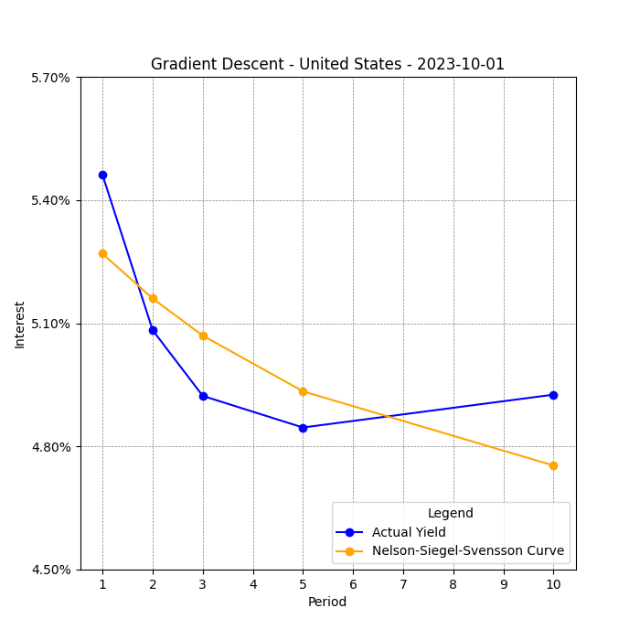
The Gradient Descent method
US:
Inverted yields curves

Slide 9

The Newton method
For each country we used the same vector of parameters for both Gradient Descent and Newton method
We have added a damping factor λ = 0,5 to ensure the Hessian is positive definite

Slide 10
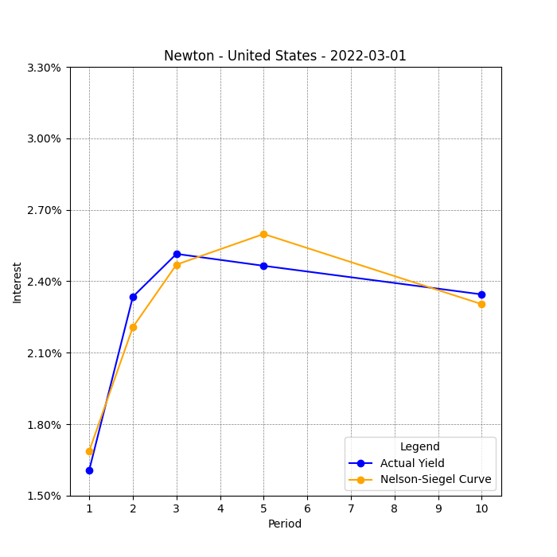
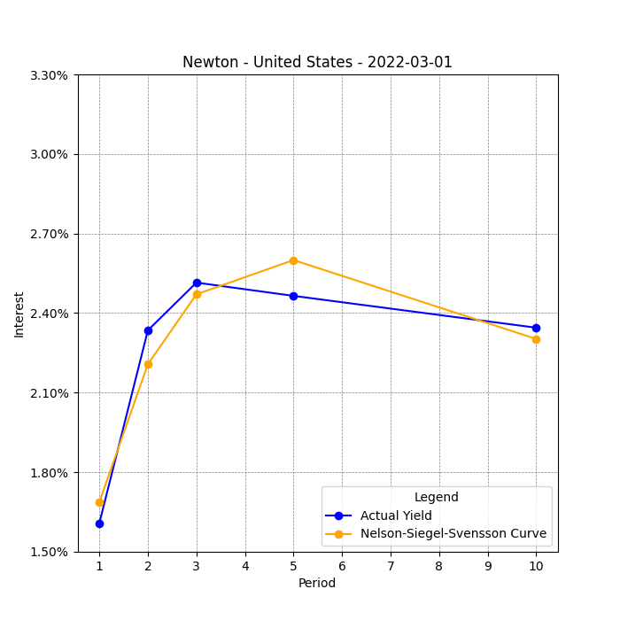
The Newton method
US:
Bonds with high volatility

Slide 11
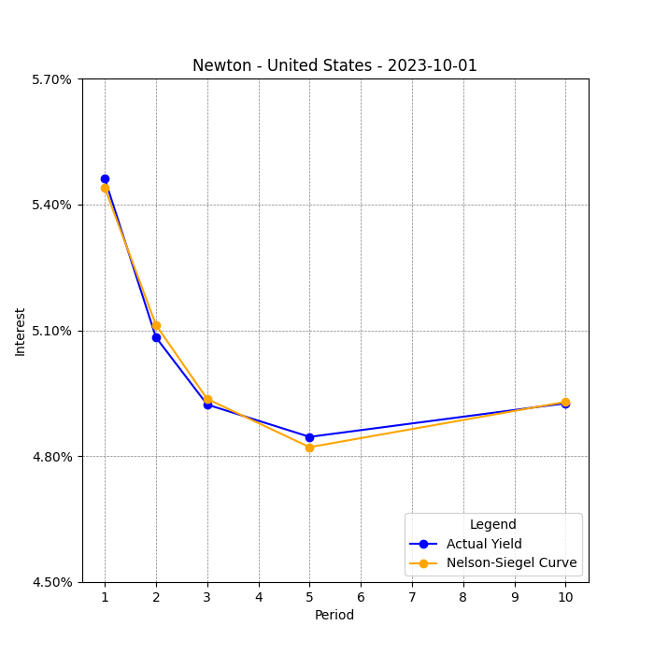
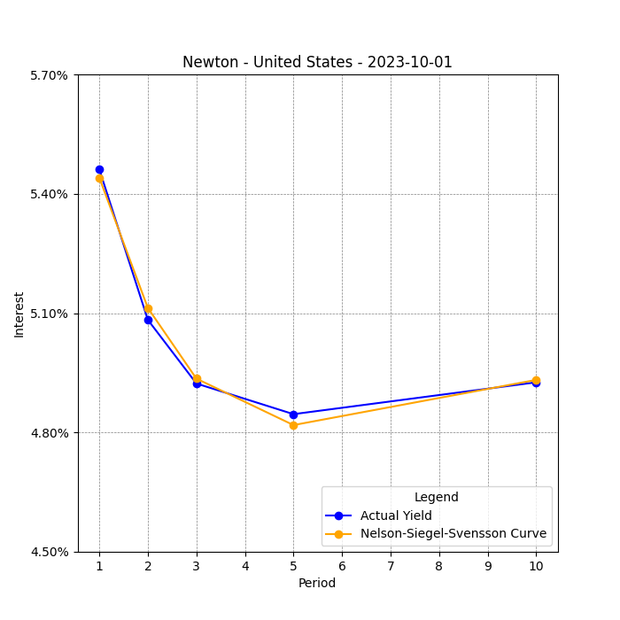
The Newton method
US:
Inverted yields curves

Slide 12
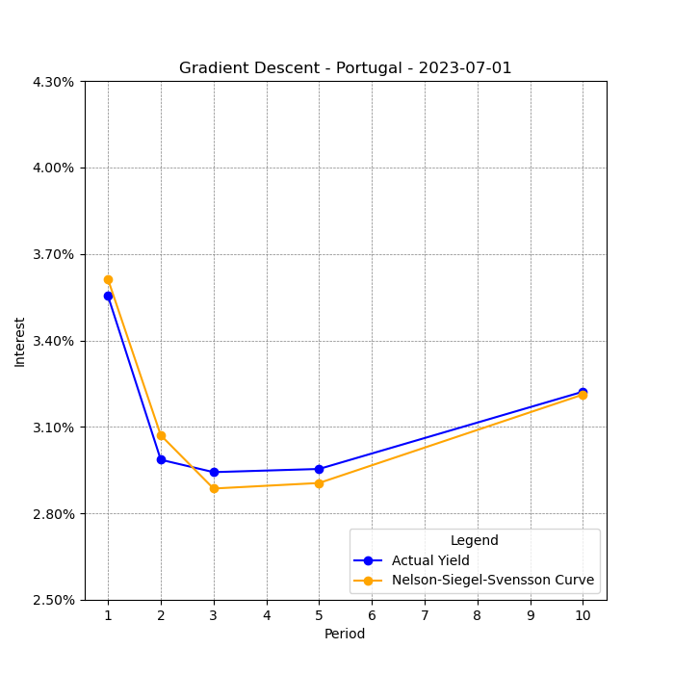
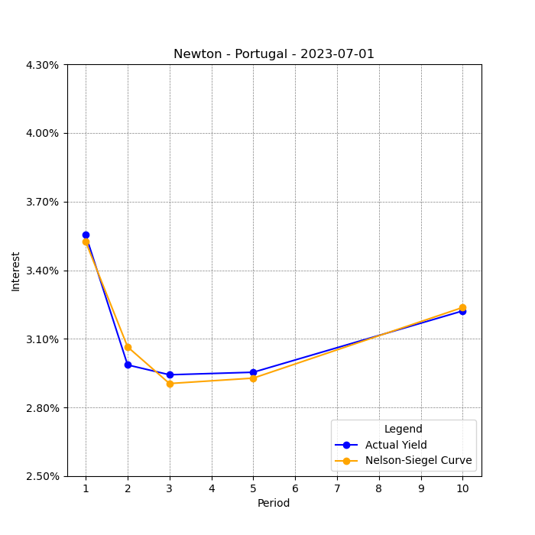
The Newton method VS GD method
Portugal:
Final remarks

Slide 13
The Newton method VS GD method
Final remarks
Newton method is way more precise than Gradient descent.
Newton is not very sensitive to the choice of starting points
It requires to compute the Hessian and its inverse, this implies a 15 times higher computational time w.r.t. GD
Gradient based methods are not able to exploit the additional term of the NSS
NSS requires less iterations than NS

Slide 14

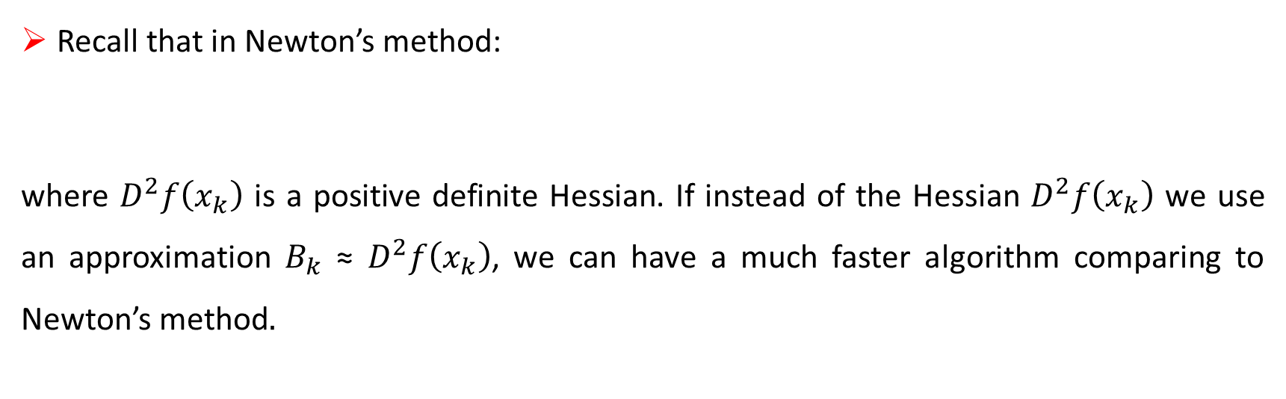
Quasi-Newton Methods and BFGS algorithm
Recall that in Newton’s method:
where $D^{2}f\left(x_{k}\right)$ is a positive definite Hessian. If instead of the Hessian $D^{2}f\left(x_{k}\right)$ we use an approximation $B_{k}$ ≈ $D^{2}f\left(x_{k}\right)$, we can have a much faster algorithm comparing to Newton’s method.
The Hessian approximation B must satisfy the quasi-Newton condition (or secant equation):

Slide 15
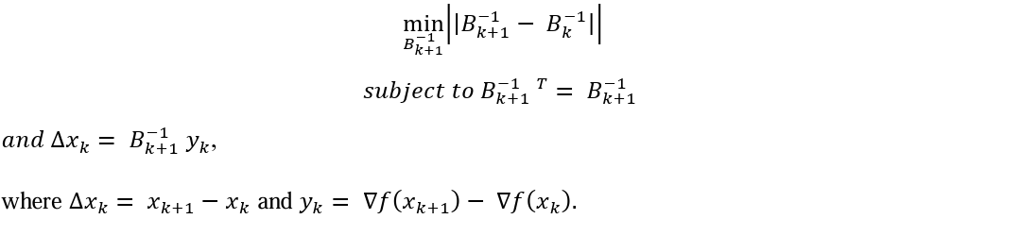
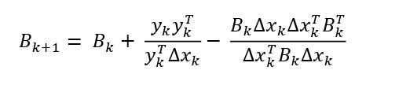
BFGS optimization

Slide 16
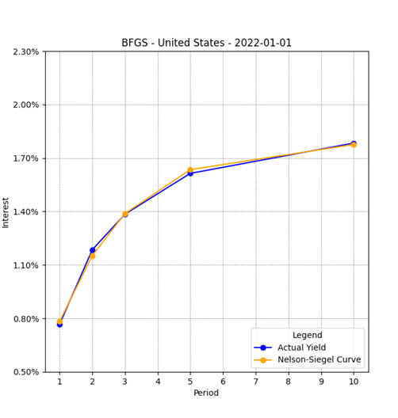
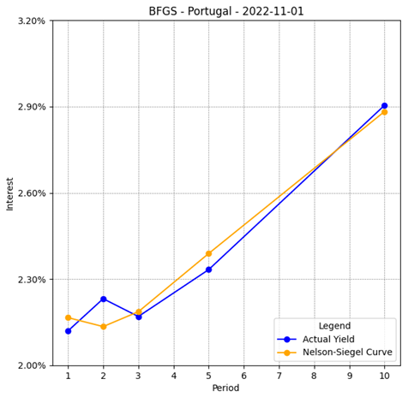
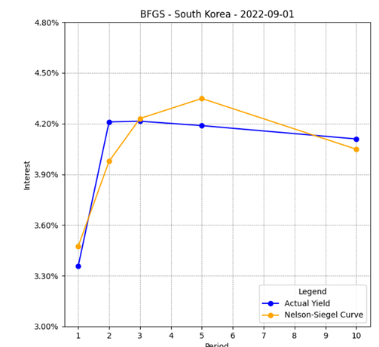
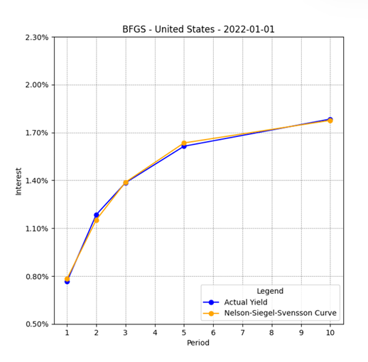
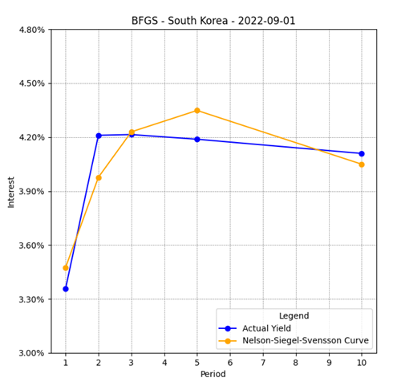
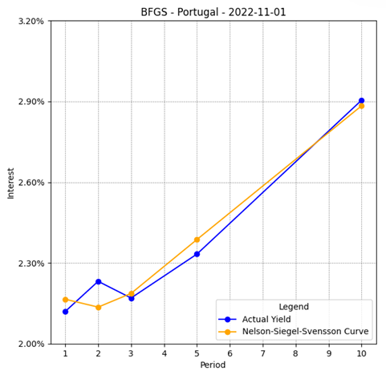
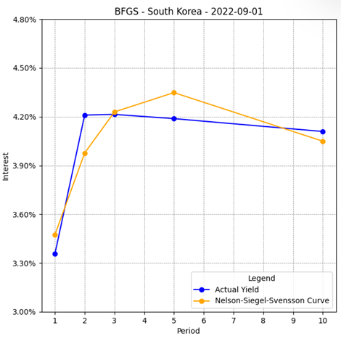

Slide 17
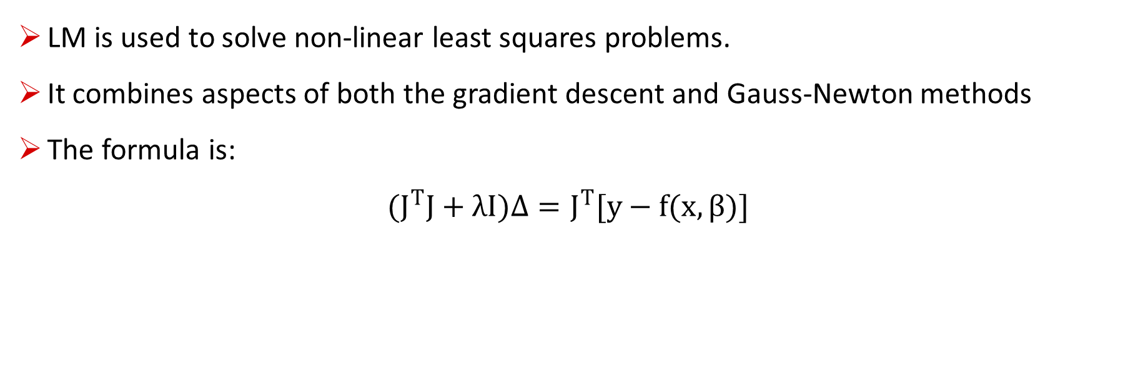
What is Levenberg-Marquardt (LM) Method?
LM is used to solve non-linear least squares problems.
It combines aspects of both the gradient descent and Gauss-Newton methods
The formula is:
$$(J^{T}J+λI)Δ=J^{T}[y−f(x,β)]$$

Slide 18
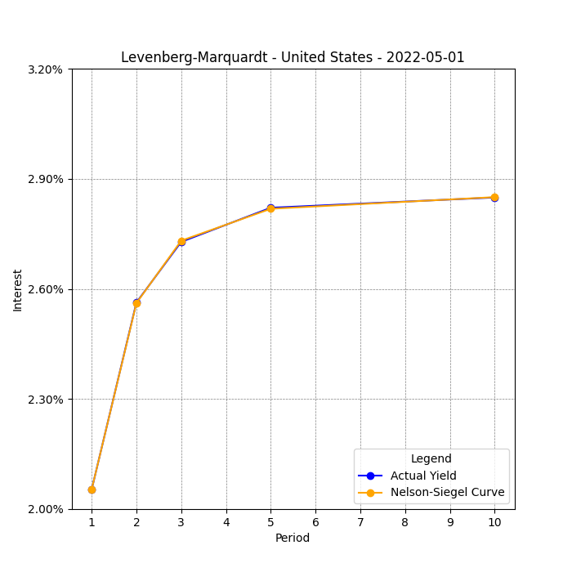
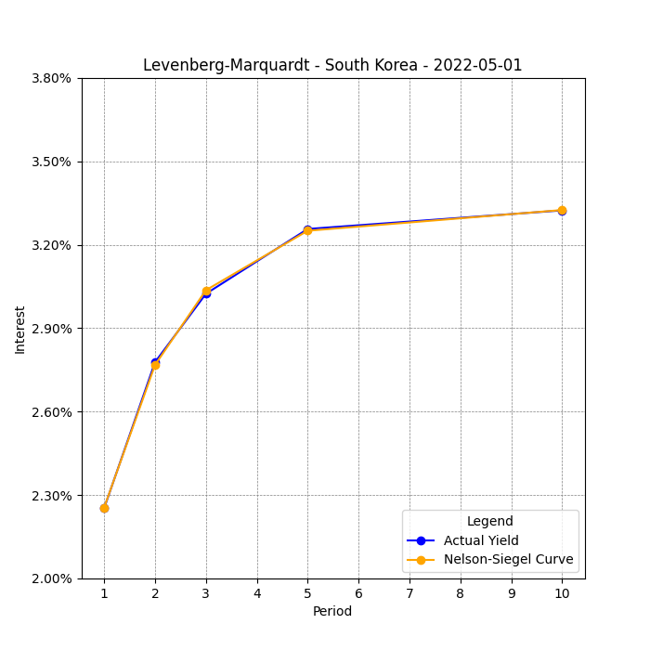


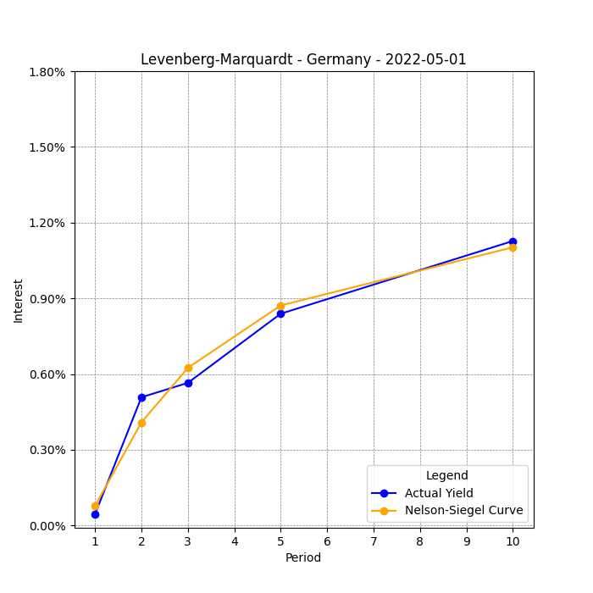
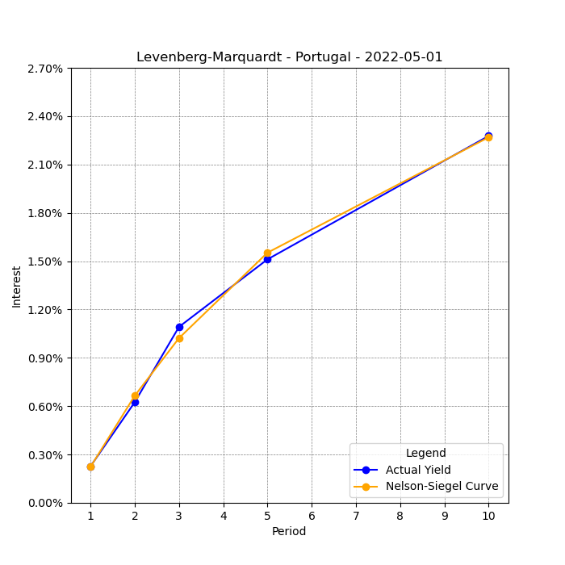


Results and Best Parameters
Demonstrates rapid convergence with high accuracy in parameter estimation.
Best parameters provide an almost perfect fit with minimal iterations.
LM algorithm does not fit the data perfectly for several reasons:
Model Limitations.
Local Minima.

Slide 19
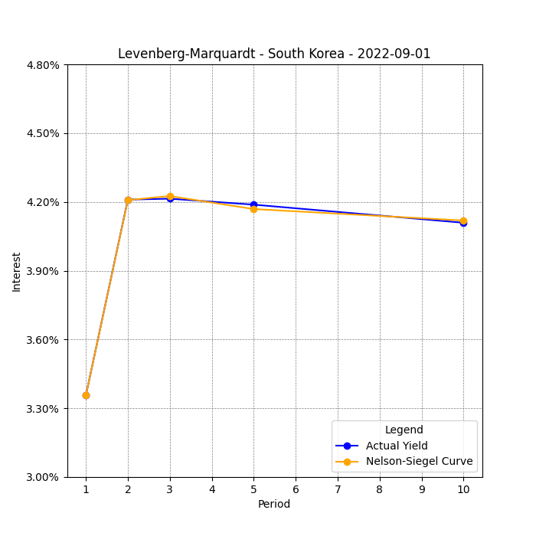
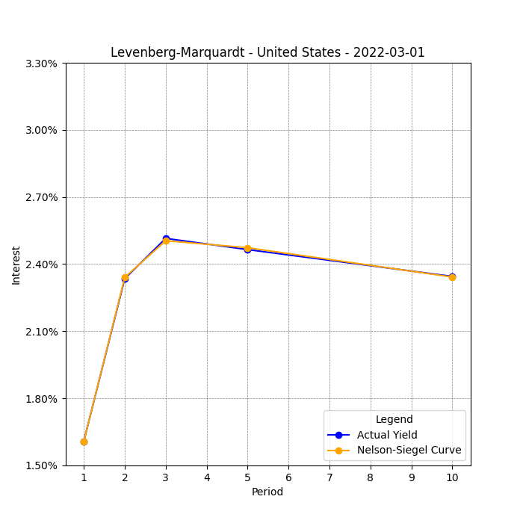
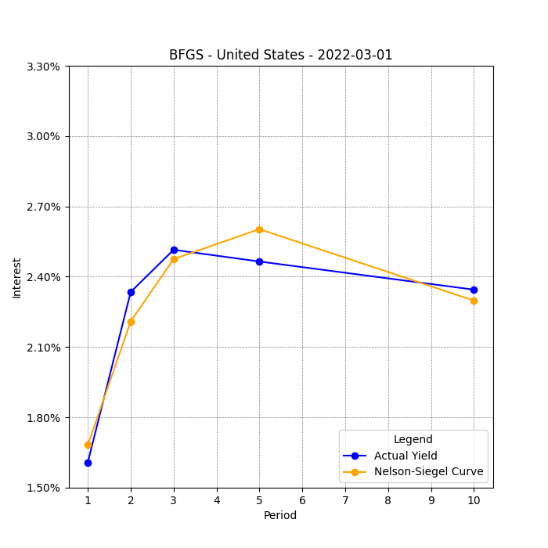
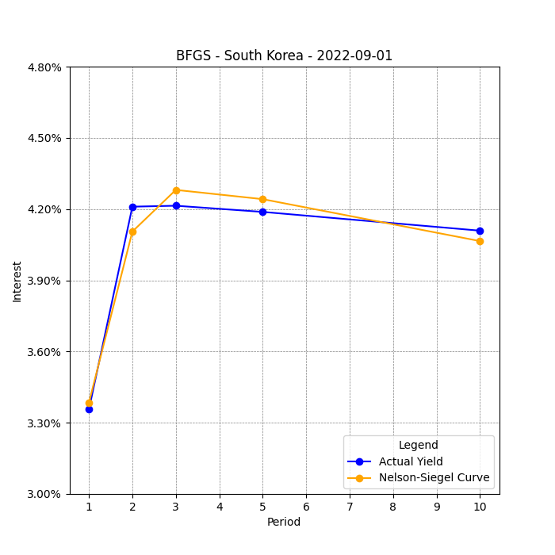


Comparison with BFGS and Newton Methods [Part I]
LM vs. BFGS:
LM and BFGS are comparable in speed.
Accuracy - both LM and BFGS accurately find best parameters.
LM is favored for its robustness.

Slide 20
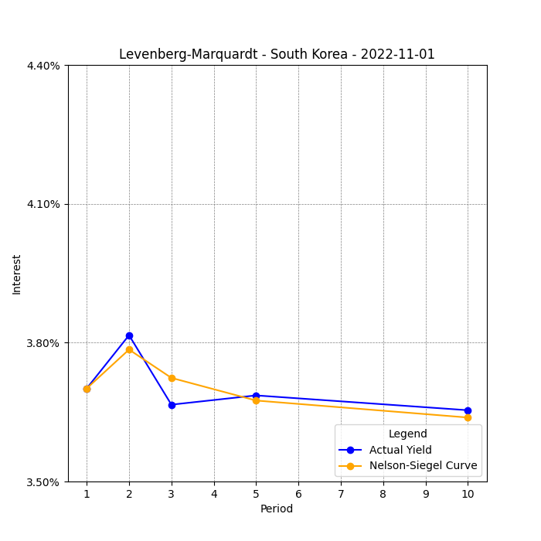
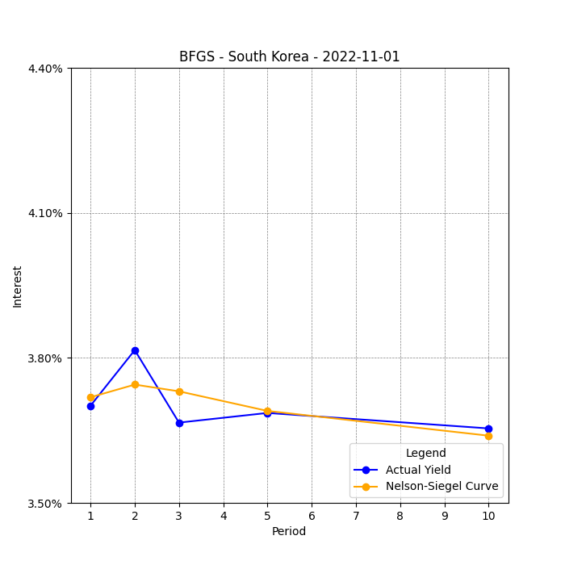
Part II: Devil in the details
LM tries to fit the second-year maturity as accurately as possible
BFGS’ graph looks more like the average between two spikes.

Slide 21
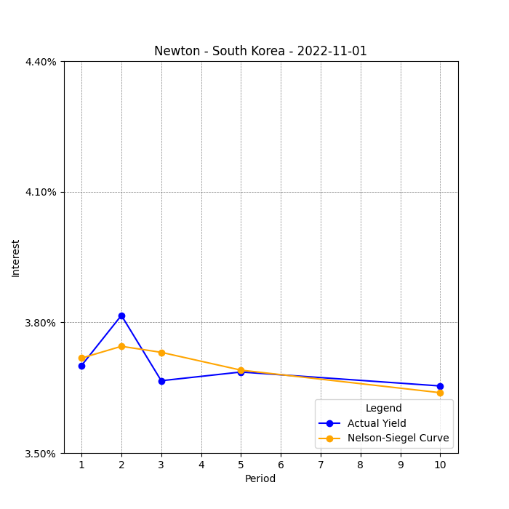
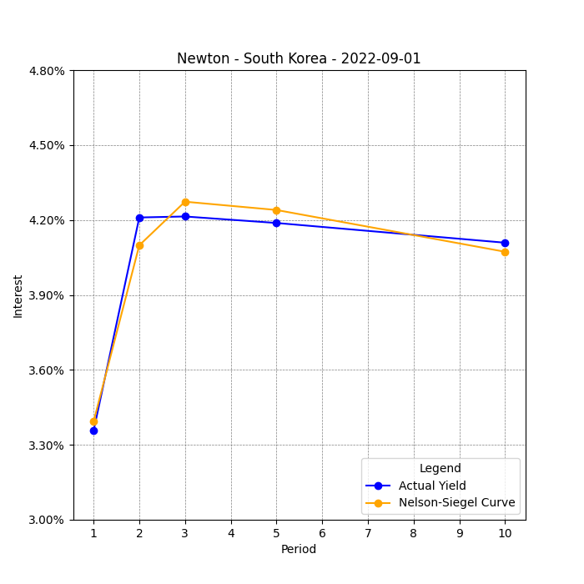
Part III: Only Newton can solve this?
LM vs. Newton:
Newton Method can struggle to provide solutions when starting far from the final minimum.
Conclusion:
The LM method is preferred for balancing speed and accuracy.
Requires careful calibration of λ

Slide 22
Thanks for the attention!
Notes:
Ringrazio i presenti

